Slide 1




LIFI
GROUP - 17
Shalu - B20229
Aryaka - B20185
Pranav - B20095
Atharva - B20282
Jayanth - B20158
Yashwant - B20074

Slide 2

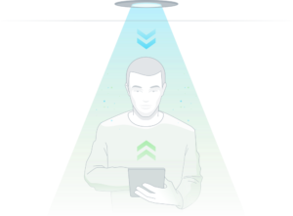
LIFI – The LiFiVerse
What Is Li-Fi?
Welcome to the world of light!!!
Li-Fi is a light-based communication technology that can send data quickly over the visible, ultraviolet, and infrared spectrums. Currently, the only lights that can be utilized to transmit data in visible light are LED lamps.
Light Fidelity
Professor Harald Haas
Text
Image
Sound

Slide 3
LIFI – The LiFiVerse
LET'S
START

Slide 4
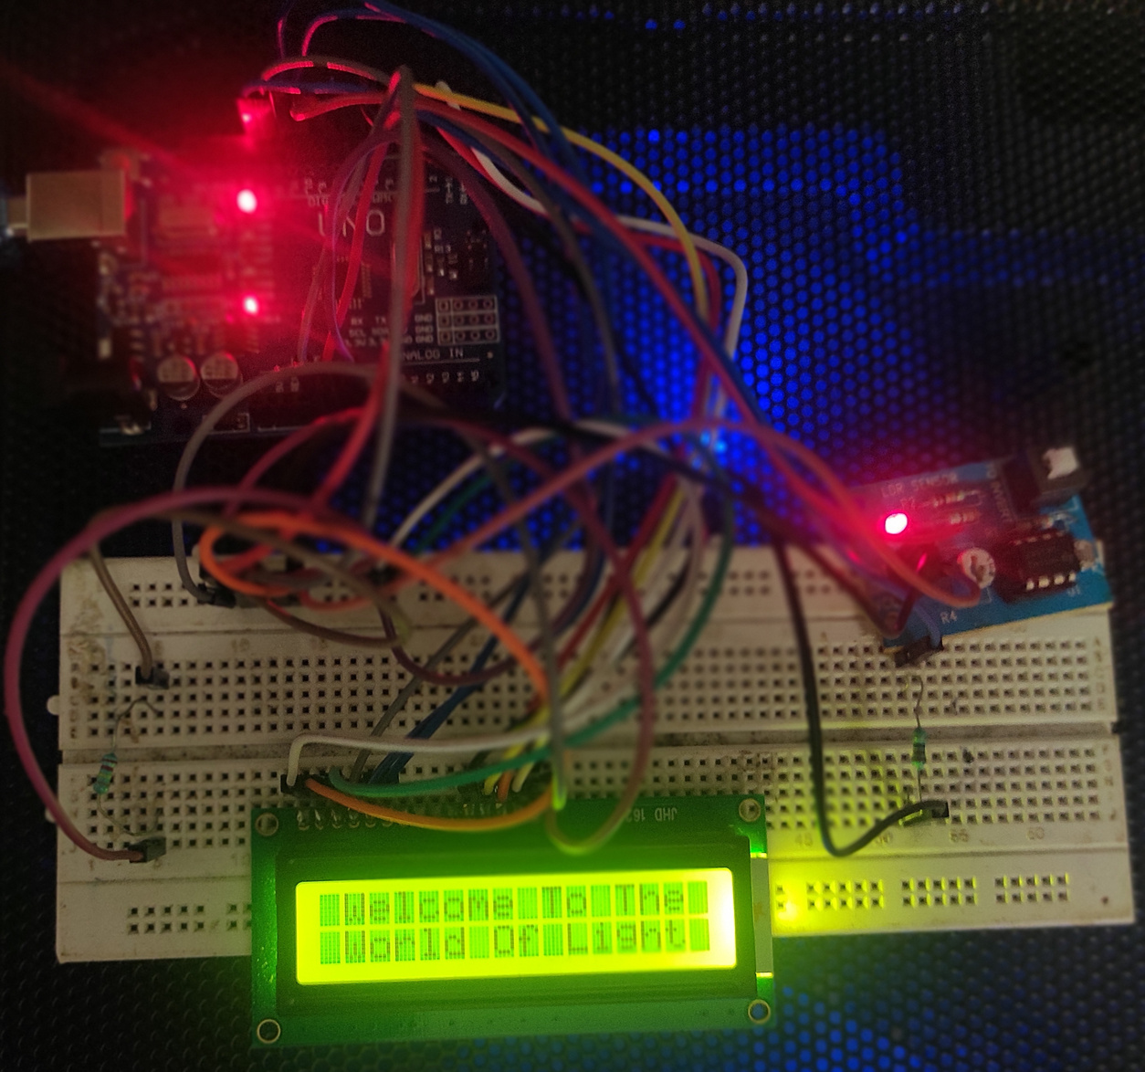
LIFI - MESSAGE AS DATA
Model - 1
Message transfer using light
In this model, we transferred messages from our mobile phones to LCD using light as a data transmitter. We used the frequency and duration of the flashlight to transmit the message through a solar panel. We made an application that take the message as an input and gives the flashlight as output which is reflected on the LDR sensor and the corresponding message is displayed on the LCD. We used Arduino Uno as the microcontroller board.
Technologies used
Arduino Uno as microcontroller board
16x2 LCD for display
LDR sensor
Duration of light for data transfer at that duration
An application which take message as input and control the flashlight of mobile as an output.

Slide 5
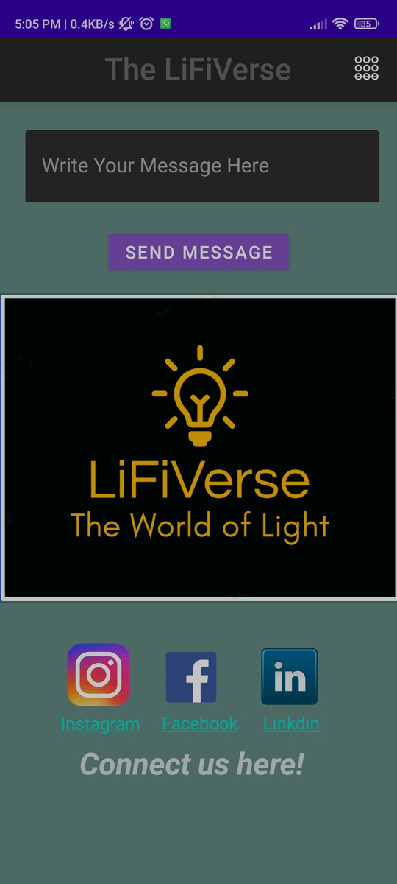

LIFI - MESSAGE AS DATA

Slide 6
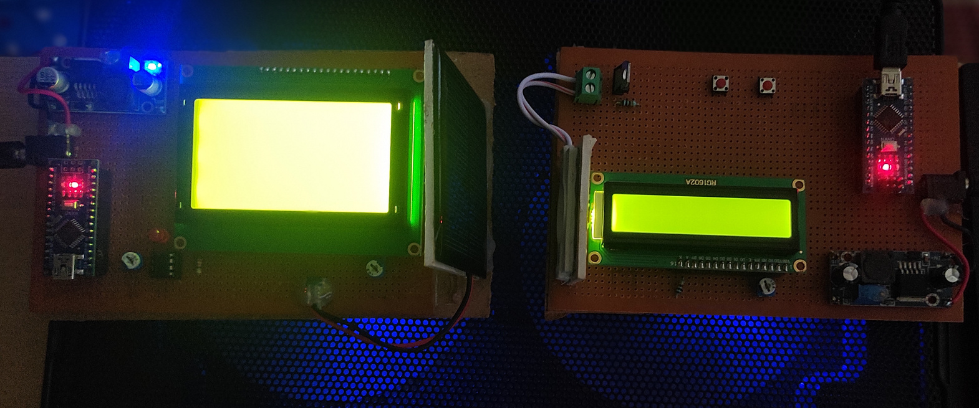
LIFI - IMAGE AS DATA
Model - 2
Image transfer using light
We transferred the image after burning the code in the transmitter and receiver which are Arduino nano. After burning the code in the transmitter, we used cool term software and take the required file type and the command is passed into the LED which will blink accordingly on the solar panel and pass the data into the receiver which processes the data and display the image onto the LCD.
Technologies used
LCD
Arduino Nano
Solar Panel
LED
Transmitter
Convertor
Switches
Proto Board
cool term software

Slide 7
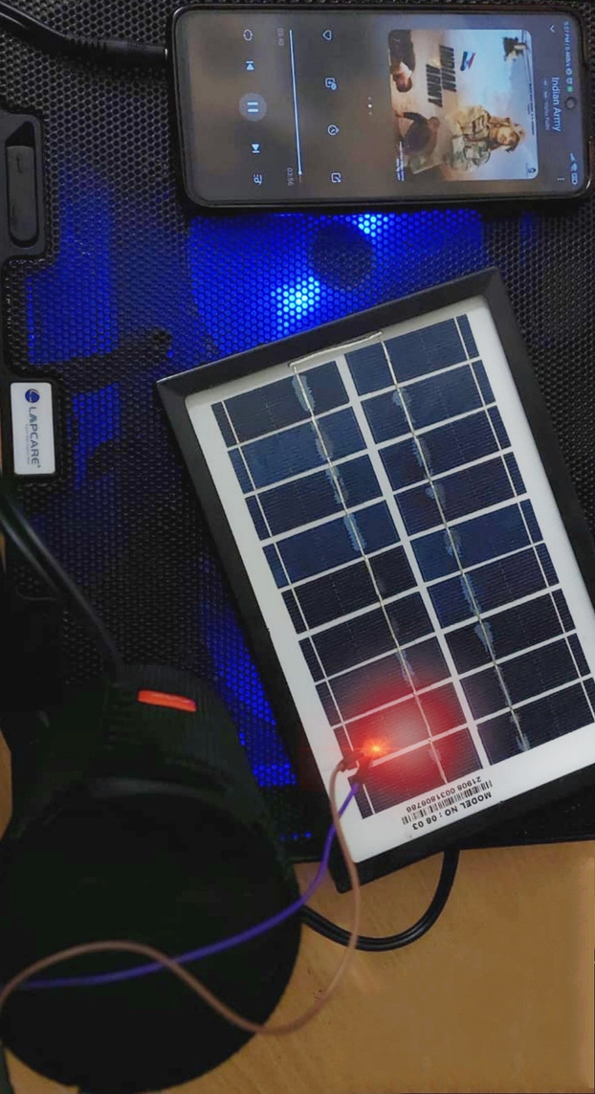
LIFI - SOUND AS DATA
Model - 3
Sound transfer using light
In this model, we transferred sound from our mobile phones to speakers using light as a data transmitter. We used fluctuations of a flashlight, which we obtained using an application, to transmit the sound through a solar panel. We made an application that takes sound as input from a mobile phone and gives a flashlight as output which is reflected on the solar panel and the corresponding sound will be audible from the speaker.
Technologies used
2 Aux cable
2 Solar Panel
Speaker
Mobile phone for data input

Slide 8
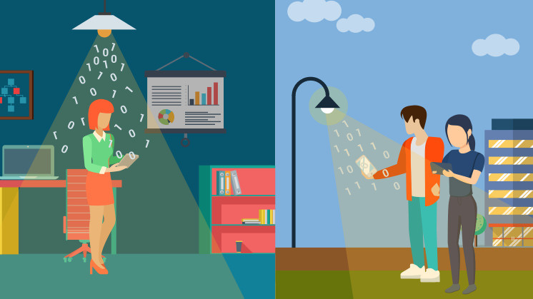
Advantages
of Lifi
Efficiency
Better Security
Unlimited Bandwidth
Higher data speeds
Since homes and offices already have LED bulbs for lighting purposes, the same source of light can be used to transmit data. Hence, it is very efficient in terms of costs as well as energy.
Since light cannot pass through opaque structures, Li-Fi Internet is available only to the users within a room and cannot be breached by users in other rooms or buildings
As the need of internet and thus data is increasing rapidly there may be a spectrum crunch of radio waves. Bandwidth of light is 2600 times the bandwidth of Wi-Fi.
Analysts at the University of Oxford have asserted that they effectively tried a trial Li-Fi application with a bi-directional speed of 224 gigabits for each second

Slide 9


SOME FACTS!
What's the catch
The Li-Fi market is predicted to exceed $80 Million in 2023, according to Energias Market Research.
In Here
While the fact that light cannot pass through walls may be advantageous in terms of security, it also severely restricts the range of Li-Fi. It is therefore only practical in confined spaces. To increase the range of the Li-Fi network in establishments, lights must be strategically positioned in rooms and hallways. Li-Fi can only reach distances of 10 meters in open areas while Wi-Fi coverage can extend up to 32 meters.
An experiment has been conducted by Apple where they tracked the geolocation of people present in a shopping mall using Li-Fi.

Slide 10
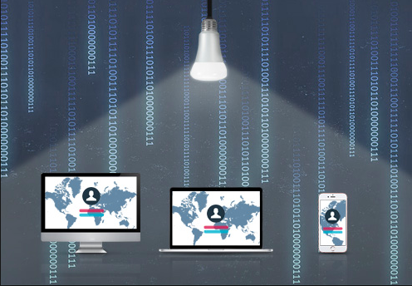
Future Scope
Current Scenario
-OPPO is trying to build a Li-Fi based smartphone which is much faster than Wi-Fi
-France has built Wi-Fi enabled classroom.
Li-Fi is more secure as it has
a very short range and it also
cannot penetrate through walls
and is difficult to hack
The application and development of Li-Fi
technologies have a lot of potential
because light is available everywhere
and is free to use
Li-Fi has the benefit of being
able to be used without
interfering in electromagnetically
sensitive environments
Li-Fi is much cheaper than
Wi-Fi and is expected to be
faster than Wi-Fi in coming years.
Each Li-Fi Bulb will be able
to transfer data as the
technology is more developed
The Li-Fi market is projected
to be worth over $6 billion
per year by 2025

Slide 11

THANK YOU

